Slide 1
Natural Gas: Fuel indeed or Fuel in need?
by
Mahdjouba BELAIFA
Head of Gas Market Analysis Department
GECF Secretariat
8th Bosphorus Summit,
Istanbul, Turkey
29th November , 2017

Slide 2
Contents
GECF Views on Natural Gas Markets
Key Challenges for Natural Gas
Credentials of Natural Gas vis-a-vis SDGs
Position of GECF towards Natural Gas Role

Slide 3
Natural Gas Consumption will continue to grow
Will it grow enough to absorb the growing supply?
Source: BP Statistical Review, Cedigaz (*) GECF assessment
World natural gas consumption growth: ~1.8% in 2016 to reach 3.54 Tcm ➔ ~63 Bcm more compared to 2015.
➔ driven by Europe (U.K., France, Germany, Italy and The Netherlands), Asia (China and India) and the Middle East region.
Expected growth in 2017: ~ 2% primarily driven by Europe and Asia.
Expected growth in 2018: ~ between 2.1% and 2.2%.
Why?:
➔ Weather conditions, economic expansion mainly in Asia (China, India), competitive prices and environmental concerns

Slide 4
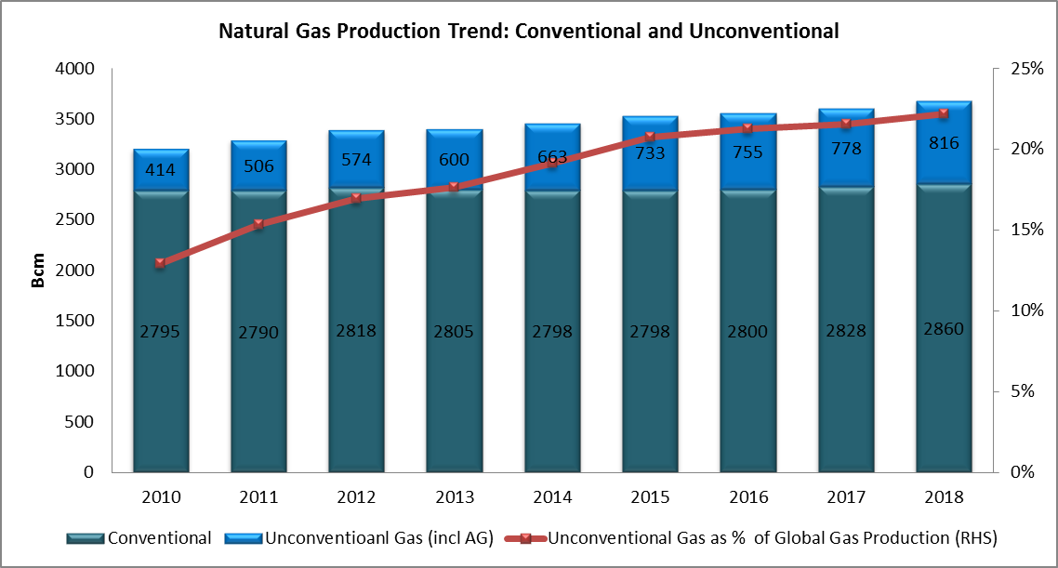
Natural Gas Production: Conventional & Unconventional Growth driven by unconventional Gas
Global natural gas production continue to grow y-o-y reaching ~ 3.6 Tcm in 2016: Unconventional gas production (shale oil and gas output in the US as oil prices pick up).
China continue to ramp up unconventional gas production to ~7.9 Bcm in 2016➔ missing the target. PetroChina and Sinopec planned to rise output from the Sichuan basin in 2017.
Conventional gas remains the dominant source of gas production (~2.8 Tcm in 2016) majorly from GECF Member countries.
More gas production expected in the future (power generation, new LNG projects and environmental concerns) with global gas production expected to top 3.7 Tcm towards 2018/2019.
Data: Rystad Energy Dec 2016 & BP June 2017, Reuters. , China’s Ministry of Land and Resources

Slide 5
Trend in Global LNG Trade
Significant Growth Triggered by New LNG Production
LNG Trade by Region
2012 -2016
LNG Trade 2016: 263 mtpa
1.2%
2.4%
1.5%
6 %
Source: ICIS LNG EDGE
Global LNG Trade grew by 6% to reach around 263 million tons in 2016.
Asia accounted for 72% of the total LNG trade followed by Europe with 15%, Middle East with 6% and Americas 6%
GECF exported ~60% of the Global LNG supplied in 2016
▲ UP: Asia 189 MT (7%) & Middle East 17 (71%)
▲▼ EQUAL: Europe 41 MT or 0.6% increase
▼DOWN: Latin America 14 MT (-22.1%) & U.S./Canada 2 MT
(-15.7%)
Regional LNG imports supplied by GECF:
Asia – 46%
Europe – 98%
Latin America – 78%
Middle East – 84%
US/Canada – 100%

Slide 6
Global LNG Trade in 2017
New Records
Global LNG Trade (mtpa)
LNG Trade by Region (mtpa)
and variation (%) y-o-y
11%
Global LNG trade grew by 11% Y-o-Y (to Oct 2017), compared to the same period in 2016, standing at about 193 Mt, driven by Asian and European markets.
Asia LNG imports jumped by +13% to average 171.80 MT (safety, environmental concerns, competitive import price & supportive energy policies in China & South Korea).
European LNG imports soared to reach almost 39Mt, 15% higher than the same period in 2016. (cold weather, nuclear outages and high coal prices).

Slide 7
LNG Capacity Projects Delays and Slower Pace of FIDs
New LNG capacity expected by 2017-2020
( MTPA)
Global LNG capacity 1964-2020
( MTPA)
Source: IGU, Petroleum Economist and updated information for these projects
Commissioning of new LNG trains: Australia, US, Russia & Malaysia & restart of Angola LNG.
2. Delay of two new projects from Australia.
About 30 MT of incremental LNG capacity expected in 2017 ➔Global installed LNG capacity to reach ~ 384 MT
3. FID: No FID so far in 2017, except Mozambique’s 3.3 MTPA Coral F-LNG while E. Guinea’s2.2 MTPA Fortuna FLNG to take FID by end 2017
Projects cancelled: Canada - North West Pacific LNG (Petronas) and Aurora LNG
➔Global LNG capacity to reach 466 MTPA by 2020
4. Post 2020:
Many GECF MCs are expected to bring additional LNG volumes via new projects, expansions, debottlenecking such as Qatar’s plans to raise its LNG production to 100 MTPA after shifting the moratorium on North Field

Slide 8
Cross Basins Arbitrage Opportunities and Gas Prices A price Convergence/ Divergence ➔Arbitrage Opportunities?
In the middle of November 2017, the cross-basin differential was $1.02/MMBtu, lower than the required minimum cross-basin shipping cost of $1.40/MMBtu for arbitrage opportunity
2017 YTD-Nov. 17, 17 Spot Price Analysis (y-o-y):
HH - $3.00/MMBtu (+ 24.8%)
NBP - $5.56/MMBtu (+23.6%)
SWE LNG - $6.17/MMBtu (+30.4%)
NEA LNG - $6.82/MMBtu (+24.4%)
Source: Argus ,Reuters, GECF Estimate, OANDA

Slide 9
Long-term drivers of the world energy demand
The World in Increasing Need of Energy
 | Historical |  |  | Forecast
 | 2000 | 2016 | Change 2000-2016 | 2020 | 2025 | 2030 | 2035 | 2040 | Change 2017-2040
Real GDP growth, % | 3.6 | 3.6 | - | 3.6 | 3.8 | 3.5 | 3.2 | 3.1 | 3.4
GDP PPP per capita, 2016 USD | 11059 | 16059 | 2.5 | 17752 | 20368 | 23115 | 25975 | 29235 | 2.5
Population, mn | 6104.6 | 7410.4 | 1.2 | 7737.1 | 8122.1 | 8482.8 | 8822.7 | 9142.9 | 0.9
Urbanization rate, % | 46.7 | 54.4 | 7.6 | 56.0 | 57.9 | 59.6 | 61.1 | 62.5 | 8.2
Car fleet, mn | 750.0 | 1302.2 | 3.5 | 1451.3 | 1629.5 | 1800.5 | 1949.3 | 2074.1 | 2.0
Number of households, mn | 1571.4 | 2060.4 | 1.7 | 2185.3 | 2346.9 | 2513.2 | 2682.0 | 2850.6 | 1.4

Slide 10
Global Primary Energy demand rises 29% between 2017 and 2040
Dominance of Fossil Fuels
Global energy demand is projected to grow by 1.1% per annum, from 13.8 to almost 17.8 Gtoe
Main drivers:
Increasing global population
Economy prosperity, primarily attributed to emerging economies
Higher living standards
Natural gas will be the fastest growing fossil fuel, increasing by 1.8% per annum to 2040

Slide 11
Global Natural Gas Consumption increases by 53% between 2017 & 2040
53%
120%
Non-OECD Asia, the Middle East and Africa will lead consumption trends.
Power generation will remain the largest natural gas sector, with 2329 bcm in 2040 and 43% of the market.
In the long-term, the transport sector will grow faster than the power sector: 3.9% per annum, compared to 2.5% in the power sector.
Industrial sector will drive gas demand, replacing oil as a raw material for petrochemical sector.
11

Slide 12
Global Share of Fuels in Electricity Generation
Global electricity is projected to grow to 41235 TWh by 2040; demand for electricity is expected to grow at an annual rate of 2.2% between 2017 and 2040
The share of gas in the power generation sector increased from 18% in 2000 to 23% in 2016
It will continue to rise to 28% in 2040: This represents the largest market share of any fuel
In 2016, the share of renewables in the global electricity mix was only 8%
Renewables will be the fastest growing fuels for electricity generation in 2040, with a share of 20%
12

Slide 13
Major Policies Developments impacting Natural Gas Markets
Japan:
- Liberilization of Electricity and retail gas market
- JFTC ruling on destination and profit sharing clauses for new contracts
- Two nulcear reactors with a capacity of 1.66 GW restarted in 2017 with more expected to be restarted in the future
Europe:
- EU Energy Policies
- New French Administration
- BREXIT
- Reduction of production from Groningen Field
Closure of Rough Storage in UK
German Elections
Italy to phase out coal power plants by 2025
China: New policy to increase natural gas share from 6% to 10% by 2020 and 15% by 2030
United States:
- New US Administration
- Higher coal consumption in
power sector
- US as a key fossil energy exporting area?
South Korea: New policy to increase natural gas share from 18% to 27% in 2030
India:
Policy for reforming energy markets, cutting subsidies and enhancing the role of natural gas
New emission standards targeting coal power
Brazil: new natural gas regulations to be sent to Congress by end-2017
Gas Market Analysis Department

Slide 14
Market Price Trends (energy equivalent basis)
JCC Crude Vs Japan LNG Vs Japan Steam Coal Prices ($/MMBtu)
Based on energy equivalent basis, gas prices fails to reflect the premium it deserves over coal and oil.
In sectorial usage, the premium should include:
Environmental credential of natural gas over oil and coal;
Efficiency
Safety
Security of Supply
Availability (Baseload)

Slide 15
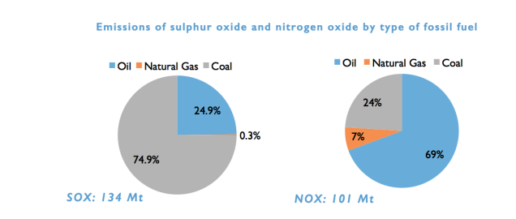
Natural Gas, as the Cleanest Fossil Fuel, has to play a key role in GHGs Mitigation Efforts
CO2 emission by unit of energy consumed (T.CO2/Toe)
Gas emits less CO2 than other fossil fuels, and also less harmful (Particles, NOx, SO2…);
Gas enjoys many advantages making it compatible with sustainable development
Good complementarity between gas and renewables;
Good energy performance of gas-based technologies and processes;
Gas is clean, abundant, affordable and allows improvement of energy accessibility.

Slide 16
GECF & Climate Change Issues
Natural Gas: Green, Abundant & Safe
Notably, Article 3
GECF Statutes
Summits Declarations (Doha, Moscow, Tehran, Santa Cruz)
Promotion of Natural Gas
Vision & Mission
Strategic Objectives
Cooperation
GECF- LTS
Market Dynamics
Unclear and Unconsistent Energy Policies, Technology Advancement, Regulations, increasing Competition, Uncertainties.
Resolutions & Approval of Studies of the Forum
MM

Slide 17
GECF’s Main Message to COP 21
GECF recognizes the importance of challenges posed by Climate Change & Global Warming
Treat environmental concern in a responsible manner through pragmatism and global policy coordination.
Natural gas as the cleanest of all known fossil fuels is in a unique position to provide the lion share of global energy needs in the coming decades
Natural gas is capable of easing the world’s transition into the age of renewable energies as the relevant substitute for pollutant fuels, such as coal, currently in widespread use.
The Declaration of the 3rd GECF Summit also underlines the role of natural gas
As fuel of choice in the global energy mix that could contribute to achieving the goals of sustainable development framework.
GECF member states are currently in possession of major global gas reserves & are in a unique position to supply clean & safe energy in sufficient volumes to meet the ever growing global energy requirements
However, development of natural gas cannot be guaranteed without adequate and secure investment, especially in the upstream sector.
Security of supply cannot be realized in a volatile environment shrouded with uncertainty;
Long-term agreements and reasonable prices play key roles in maintaining security of supply essential for both producers and consumers of natural gas.
To that end, collective efforts are required to adopt proper policies and instruments to expedite the promotion of natural gas against pollutant fuels.

Slide 18
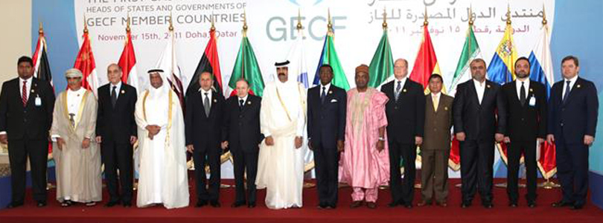
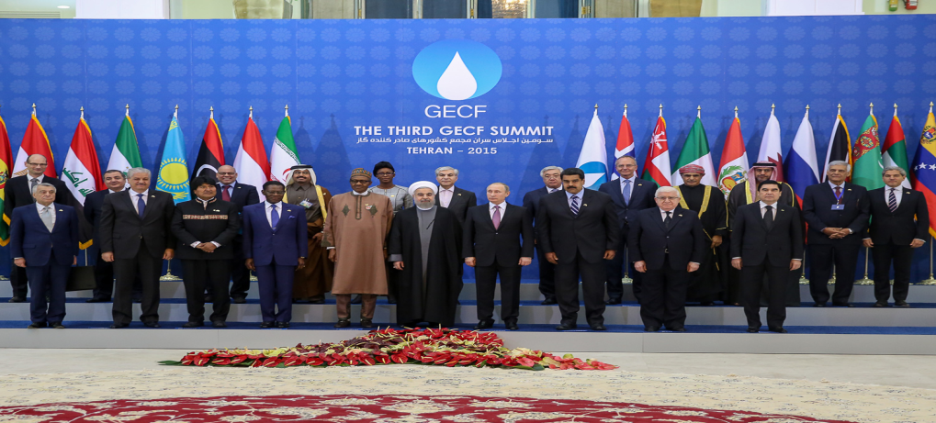
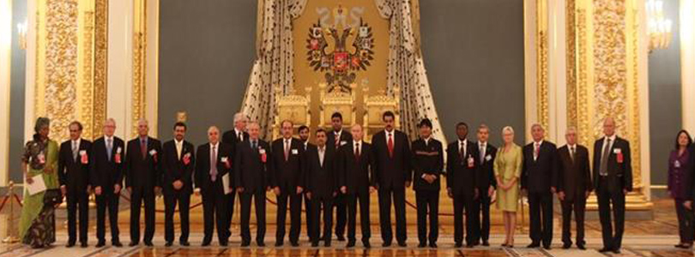
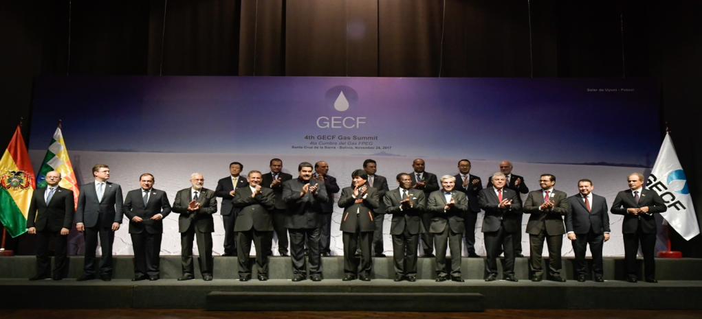
From the Summits Declarations of GECF Heads of State
1st Summit-Doha Declaration: Natural Gas: The answer to the 21st century’s sustainable development challenge: Green fuel, Abundant resource, Safe alternative
3rd Summit-Tehran Declaration: Natural Gas: Fuel of choice for sustainable development
2nd Summit-Moscow Declaration: Natural Gas: The answer to the 21 century’s sustainable development challenges
4th Summit: Santa Cruz de la Sierra Declaration: Natural Gas: Clean and Reliable Resource for Global Sustainable Development

Slide 19
Thank You
for Your Attention

